Slide 2
c.count()

Slide 4
class Counter:
def __init__(self):
self.num = 0
def count(self):
self.num += 1
print(self.num)

Slide 6
b
c

Slide 7
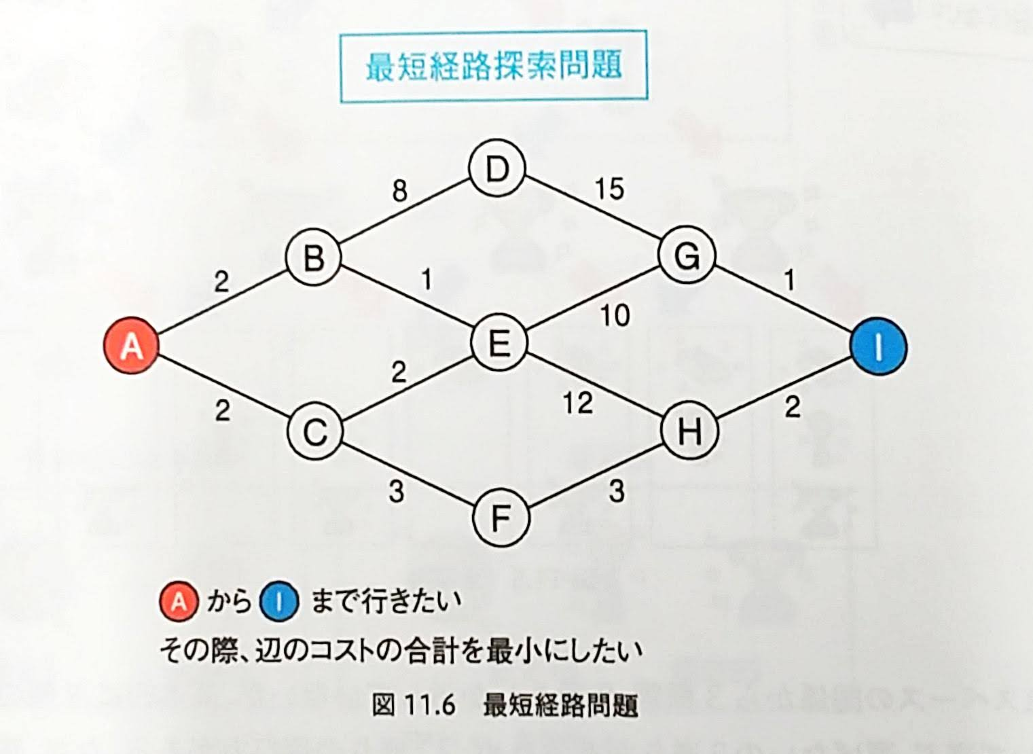

Slide 8
7

Slide 9
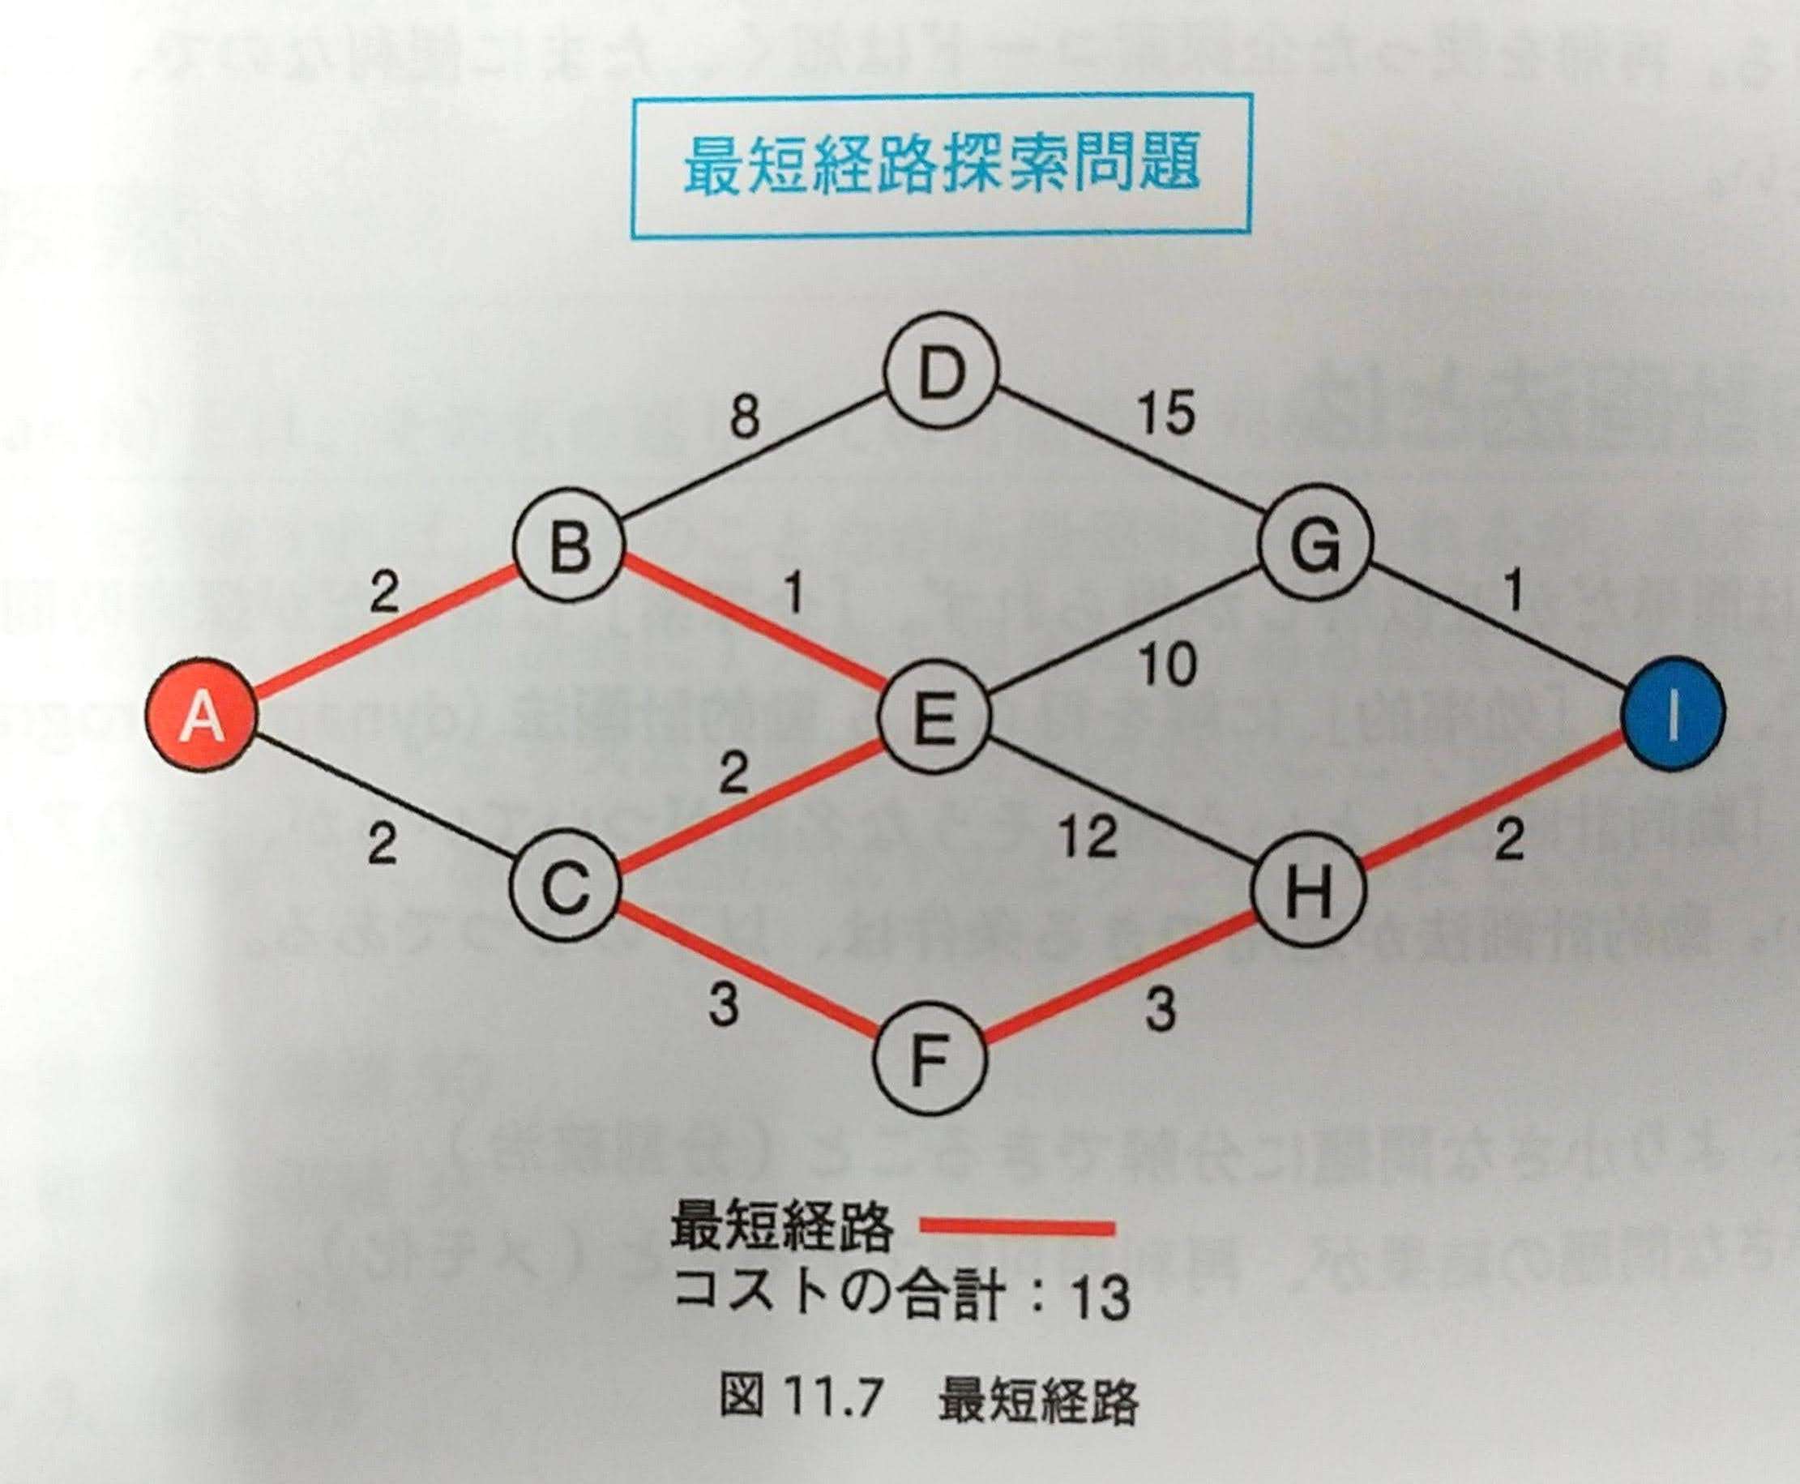

Slide 10
7

